Slide 1
Lab meeting 19/11/19
Cloning
&
Flow cytometry

Slide 2
Cloning

Slide 3

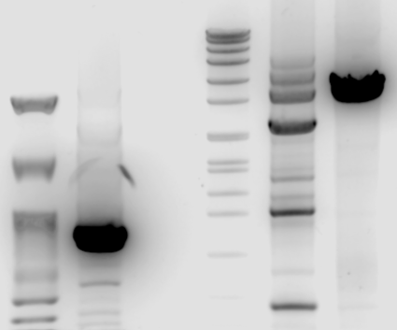
hDHCR7, hDHCR24 & hSC5D – primers test
Nippon 100pb
hDHCR7 fw1/rv1
Marker VII
hDHCR24 fw3/rv3
hSC5D fw6/rv6
8576
7427
6106
3’UTR | Size (bp) | miRNA site type
hDHCR7 | 871 | 7mer-m8
hDHCR24 | 2548 | 7mer-A1
hSC5D | 3425 | 8mer, 7mer-m8
4899
~3425bp
3639
3000
2799
1953
1882
1500
1515
1482
1164
1000
~871bp
992
900
710
500
400
300

Slide 4
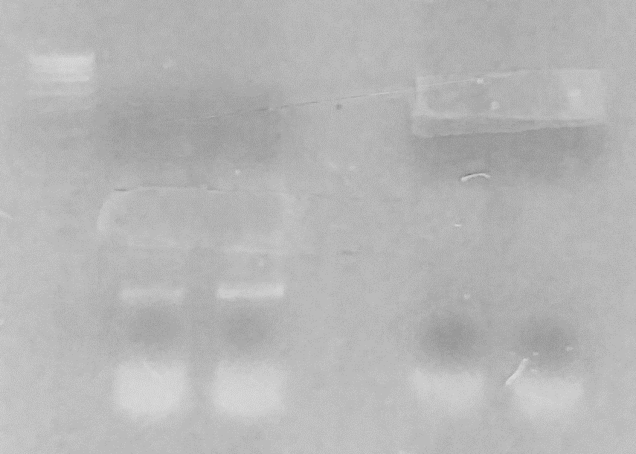
hDHCR7 & hSC5D – insert amplification
Marker VII
hDHCR7
hSC5D

Slide 5
Cloning – In progress
Cloning of 3’UTRs hDHCR7 and hSC5D in psiCHECK2 plasmid
Luciferase assay of cloned 3’UTRs
Point mutation of 3’UTRs
mDHCR24
hDHCR7
hSC5D
mSC5D sequencing with primers located in the middle of the sequence

Slide 6
Flow cytometry

Slide 7
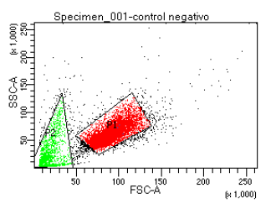
Mitochondrial dyes test
Negative control
Dyes | Detects | Control
TMRM | Mitochondrial membrane potential (ΔΨm) | FCCP
MitoSOX (2-4 µM) | Superoxides | Rotenone Antimycin A

Slide 8
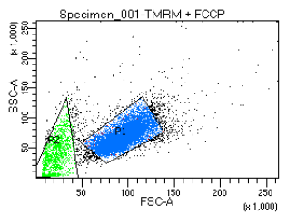
Mitochondrial dyes test
TMRM
TMRM+FCCP

Slide 9
Mitochondrial dyes test
MitoSOX 2µM
MitoSOX + Ant/Rot

Slide 10
MTK Red + Green N2A (IMDEA)
Control -
MTK Red control
MTK Green control

Slide 11
MTK Red + Green N2A (IMDEA)
CM
miR7

Slide 12
MTK Red + Green (IMDEA)
Repeat in CBMSO (and IMDEA) with technical triplicates

